Slide 1

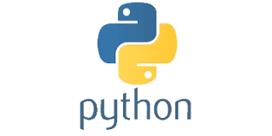
PYTHON
Lecture 4

Slide 2

Today’s Agenda
More About print() , IDLE, Error, Identifiers,
Reserved Words
Introduction To Predefined Functions And Modules
How print() function works ?
How To Remove Newline From print( ) ?
Introduction TO IDLE
Types Of Errors In Python
Rules For Identifiers
Python Reserved Words

Slide 3
Types Of Predefined Function Provided By Python
Python has a very rich set of predefined functions and they are broadly categorized to be of 2 types:
Built In Functions
Functions Defined In Modules

Slide 4
Built In Functions
Built in functions are those functions which are always available for use .
For example , print() is a built-in function which prints the given object to the standard output device (screen)
As of version 3.8.3 , Python has 69 built-in function and their list can be obtained on the following url :
https://docs.python.org/3/library/functions.html

Slide 5
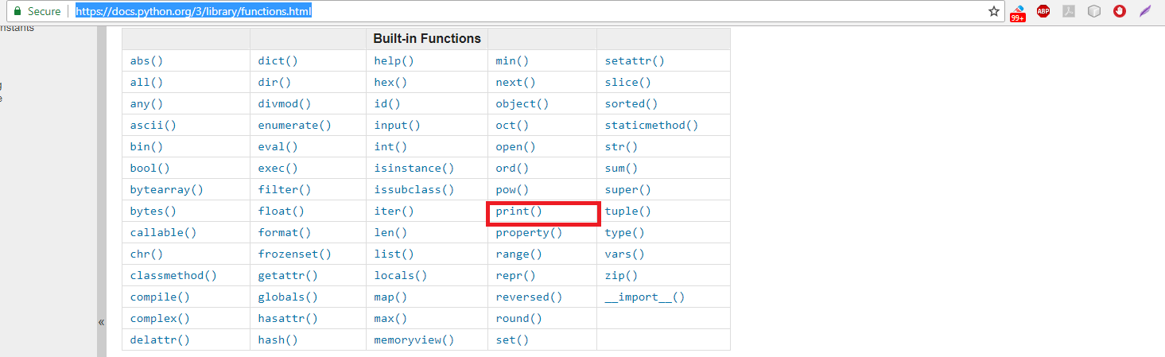
What Is print( ) And How It Is Made Available To Our Program ?

Slide 6
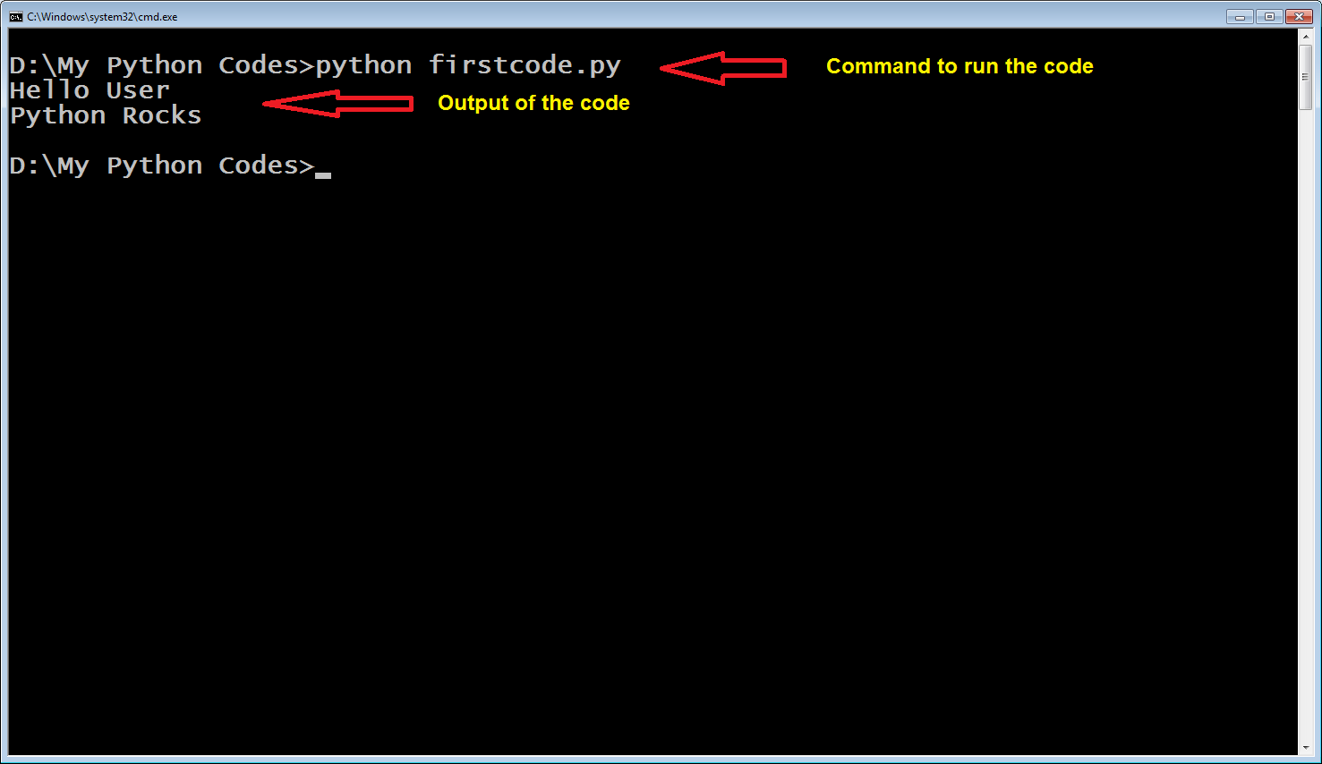
How To Remove newline From print() ?
Let us revisit our firstcode.py file . The code was
print("Hello User")
print("Python Rocks")

Slide 7
How To Remove newline From print() ?
If we closely observe , we will see that the 2 messages are getting displayed on separate lines , even though we have not used any newline character.
This is because the function print() automatically appends a newline character after the message it is printing.

Slide 8
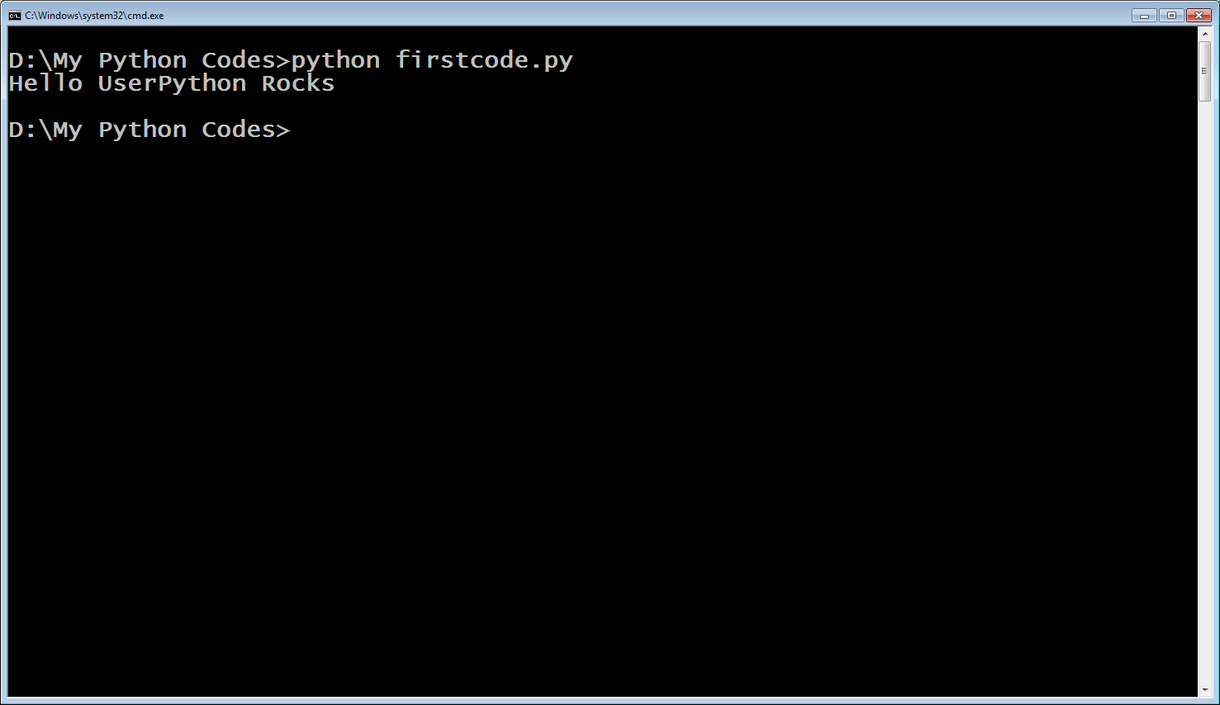
How To Remove newline From print() ?
If we do not want this then we can use the print() function as shown below:
print(“Hello User”,end=“”)
print(“Python Rocks”)

Slide 9
How To Remove newline From print() ?
The word end is called keyword argument in Python and it’s default value is “\n”.
But we have changed it to empty string(“”) to tell Python not to produce any newline.
Similarly we can set it to “\t” to generate tab or “\b” to erase the previous character

Slide 10

Some Examples
1.
print("Hello User",end="\t")
print("Python Rocks")
2.
print("Hello User",end="\b")
print("Python Rocks")

Slide 11
Functions Defined In Modules
A Module in Python is collection of functions and statements which provide some extra functionality as compared to built in functions.
We can assume it just like a header file of C/C++ language.
Python has 100s of built in Modules like math , sys , platform etc which prove to be very useful for a programmer

Slide 12
Functions Defined In Modules
For example , the module math contains a function called factorial( ) which can calculate and return the factorial of any number.
But to use a module we must first import it in our code using the syntax :
import <name of the module>
For example: import math
Then we can call any function of this module by prefixing it with the module name
For example: math.factorial(5)

Slide 13
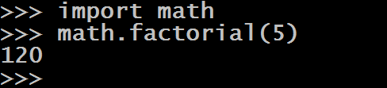

Functions Defined In Modules

Slide 14
Introducing IDLE
When we install CPython , along with other tools we also get a lightweight Integrated Development Environment or IDLE for short.
The IDLE is a GUI based IDE for editing and running Python programs
IDLE has two main window types, the Shell window and the Editor window.
Shell window is same as command shell and Editor window is same as notepad but both have colorizing of code , input, output, and error messages.

Slide 15
Introducing IDLE
To start IDLE on Windows click the Start Menu and search "IDLE" or "idle".
Right Click IDLE as select Run as administrator and you will see a window as shown in the next slide

Slide 16
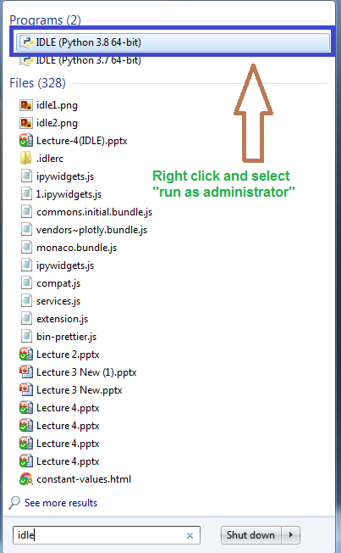
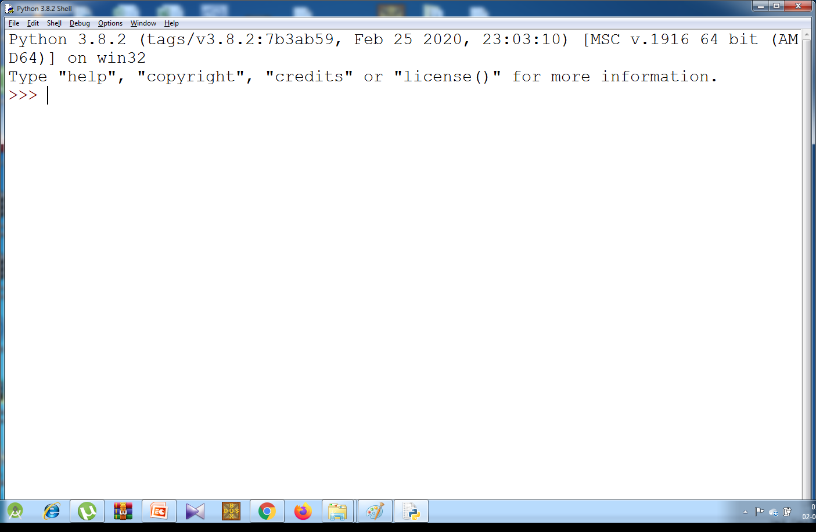
Opening IDLE

Slide 17
Using IDLE
This is again Python Shell, but a much more colourful as compared to the previous Shell window
Just type the commands, hit enter and it will display the result.

Slide 18
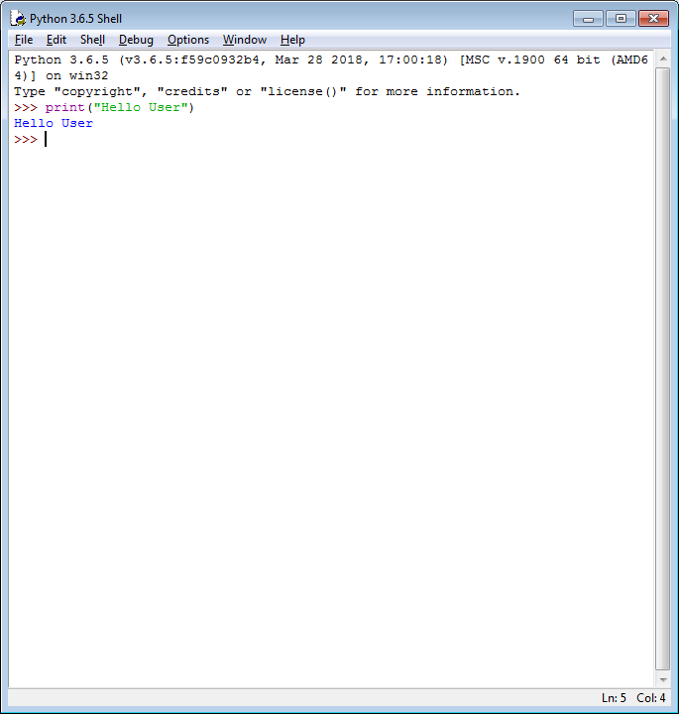
Using IDLE

Slide 19
Using IDLE’s Editor Window
IDLE also has a built-in text editor to write Python programs.
To create a new program go to File > New File.
A new Untitled window will open. This window is a text editor where we can write programs.

Slide 20
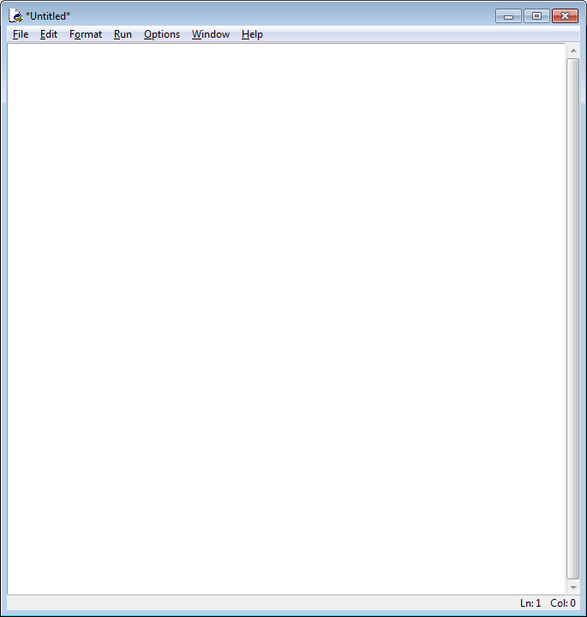
Using IDLE’s Editor Window

Slide 21
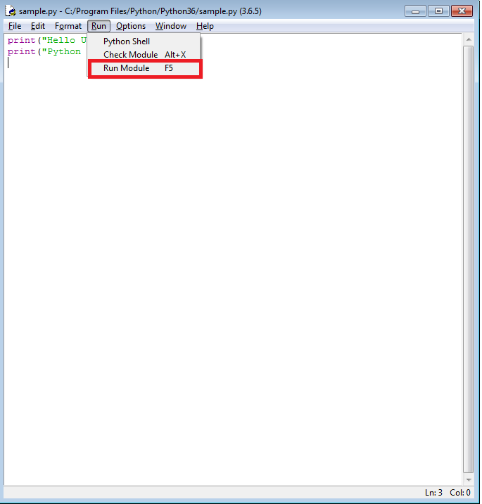
Using IDLE’s Editor Window
Save the file as sample.py and to run the program, Go to Run > Run Module or Hit F5.

Slide 22
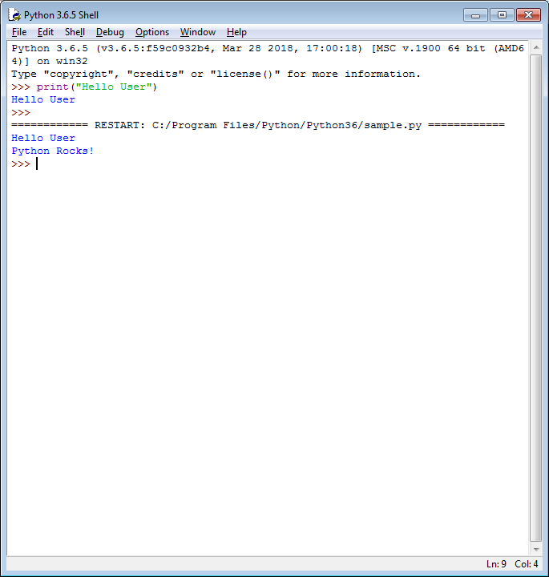
Using IDLE’s Editor Window
By doing this the editor window will move into the background, Python Shell will become active and we will see the output

Slide 23
Types Of Errors In Python
Just like any other programming language , Python also has 2 kinds of errors:
Syntax Error
Runtime Error

Slide 24
Syntax Error
Syntaxes are RULES OF A LANGUAGE and when we break these rules , the error which occurs is called Syntax Error.
Examples of Syntax Errors are:
Misspelled keywords.
Incorrect use of an operator.
Omitting parentheses in a function call.

Slide 25
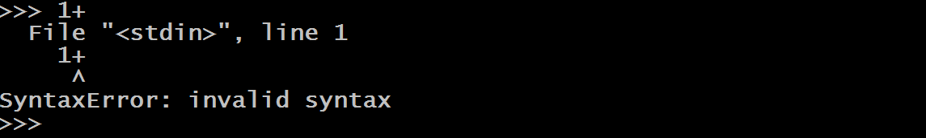
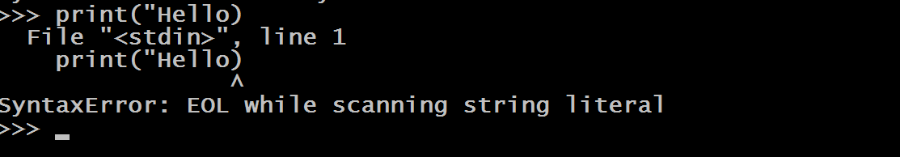
Examples Of Syntax Error

Slide 26
RunTime Errors (Exceptions)
As the name says, Runtime Errors are errors which occur while the program is running.
As soon as Python interpreter encounters them it halts the execution of the program and displays a message about the probable cause of the problem.

Slide 27
RunTime Errors (Exceptions)
They usually occur when interpreter counters an operation that is impossible to carry out and one such operation is dividing a number by 0.
Since dividing a number by 0 is undefined , so ,when the interpreter encounters this operation it raises ZeroDivisionError as follows:

Slide 28
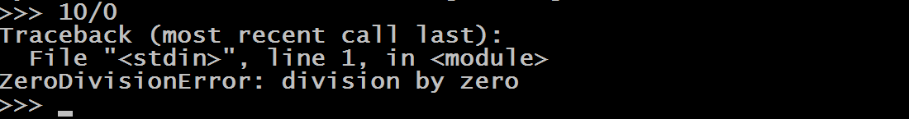
Example Of RunTime Error

Slide 29
Rules For Identifiers
What is an identifier ?
Identifier is the name given to entities like class, functions, variables , modules and any other object in Python.
Rules for identifiers:
Identifiers can be a combination of letters in lowercase (a to z) or uppercase (A to Z) or digits (0 to 9) or an underscore (_)
No special character except underscore is allowed in the name of a variable

Slide 30
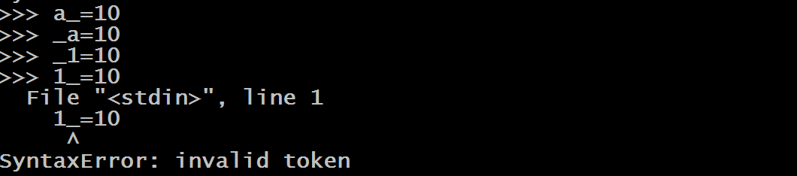
Rules For Identifiers
It must compulsorily begin with an underscore ( _ ) or a letter and not with a digit . Although after the first letter we can have as many digits as we want. So 1a is invalid , while a1 or _a or _1 is a valid name for an identifier.

Slide 31
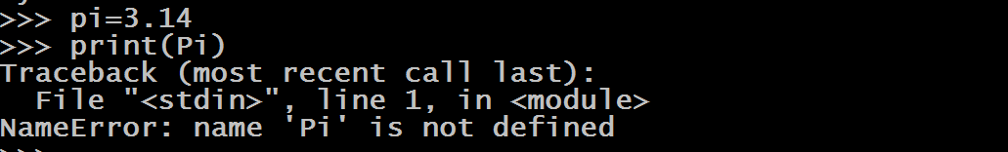
Rules For Identifiers
Identifiers are case sensitive , so pi and Pi are two different identifiers.

Slide 32
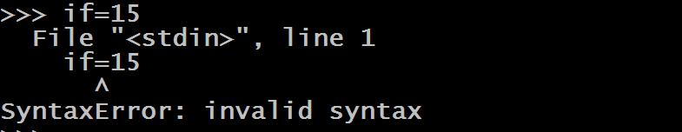
Rules For Identifiers
Keywords cannot be used as identifiers
Identifier can be of any length.

Slide 33
Rules For Reserved Words
What is a Reserved Word?
A word in a programming language which has a fixed meaning and cannot be redefined by the programmer or used as identifiers
How many reserved words are there in Python ?
Python contains 35 reserved words or keywords
The list is mentioned on the next slide
We can get this list by using help() in Python Shell

Slide 34
Rules For Reserved Words
These 35 keywords are:
False , True , None ,def,
del ,import ,return ,
and , or , not ,
if, else , elif ,
for , while , break ,continue,
is , as , in ,
global , nonlocal ,yield ,
try ,except , finally, raise,
lambda ,with ,assert ,
class ,from , pass ,
async,await
Some Important Observations:
Except False , True and None all the other keywords are in lowercase
We don’t have else if in Python , rather it is elif
There are no switch and do-while statements in Python

